Slide 1

AI VS
LAWYERS
Disruptor, Partner, or Replacement?

Slide 2

AI In the Legal Profession
1
4
7
Legal Research
Legal Analytics
Contract Review
2
5
8
Compliance Monitoring
Electronic Discovery
Litigation Analysis
3
Client Communications
6
Document Automation
9
Real-time Transcription

Slide 3

Examples of AI Tools
  SheriaHub Expert
  Legal Interact
  Thomson Reuters CoCounsel
  Luminance
  Spellbook
  Lex Machina
  Diligen
  Otter.ai
  Compliance.ai

Slide 4

Is AI a Threat or an Opportunity?
  A recent study from Thomson Reuters showed that 72% of legal professionals surveyed in the report view AI as a force for good in their profession.
  Half of law firm respondents cite exploring and implementing AI as their highest priority.
  In addition, they believe AI could help address other priorities, such as increased customer satisfaction and operational efficiency.
  AI is automating routine tasks, increasing operational efficiency, and improving productivity.

Slide 5
Is AI a Threat or an Opportunity?
On the other hand, AI is shifting power and autonomy to legal clients in several key ways:
  Enhancing access to legal knowledge;
  DIY legal solutions;
  Automation in contract review and negotiations means clients have the option to no longer rely solely on lawyers to interpret complex legal language;
  AI-driven ODR platforms like Modria help resolve disputes in e-commerce, family law, and consumer protection without needing a courtroom.

Slide 6


Can AI Replace Lawyers?
  It is highly unlikely that AI will replace lawyers. It is more likely to augment the work of lawyers than to replace them entirely.
  AI struggles with ethical judgement, critical thinking and understanding, and negotiation skills.
  Courtroom advocacy requires persuasion, empathy, the ability to think on your feet and make adjustments on-the-fly.
  Legal cases often present moral and ethical dilemmas that require human judgement. AI lacks conscience and the ability to make moral or ethical judgements..
  AI cannot be held accountable and should therefore not be entirely responsible for making decisions impacting human lives.
  The legal system and laws in general evolve through interpretation and debate. AI can only provide pattern recognition.

Slide 7

1
Bias and Fairness in AI decision making.
2
Accuracy of information presented as factual.
Ethical & Regulatory Challenges of AI in Law
3
Data privacy and security concerns over voluminous data.
4
Accountability in instances where AI makes errors.
5
Transparency and explainability of decisions made by AI
6
Potential for harm when AI is used in criminal justice and immigration

Slide 8

Practical Strategies to Adapt to AI
1
2
3
Understanding AI in Legal Practice
Integrating AI into your Workflows
Future-Proofing your Legal Practice
  Learn the basics of AI
  Understand key AI applications in law
  Familiarize yourself with ethical concerns around AI
  Develop an AI governance framework to assess risks and responsibilities
  Identify opportunities to improve your workflows using AI
  Conduct an AI-readiness assessment
  Evaluate AI solutions according to your needs
  Ensure compliance with Data Protection Laws
  Conduct cost-benefit analyses
  Start with low-risk AI such as legal research tools
  Integrate solutions using strategies that guarantee minimum disruption
  Develop and continuously upskill yourself in AI Literacy and proficiency
  Continuously evaluate new solutions to improve your business consistently
  Develop AI-resilient business strategies e.g. focusing on value-added services that require human expertise, such as negotiation and advocacy.
  Foster a culture of innovation

Slide 9


THANK YOU!

Slide 10
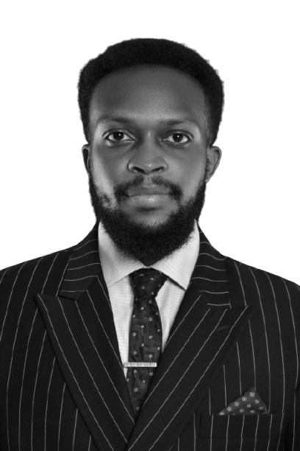
Nelson Nkari is a multidisciplinary professional with a unique blend of expertise in law and software engineering. With over three years of legal practice and more than six years of experience in software development, he possesses a deep understanding of the intersection between law and technology, particularly in the realm of digital and emerging technologies.
As the Founding and Managing Partner of Nelson Nkari & Company Advocates, a tech-enabled law firm, he specializes in providing tailored legal solutions to technology-driven businesses. His ability to speak the same language as engineers, product managers, and tech executives allows him to bridge the gap between law and technology, enabling him to: provide guidance on navigating complex regulatory landscapes; anticipate and mitigate risks at the code and technology infrastructure level; and offer strategic guidance to clients in the digital economy.
Nelson is also a recognized authority in Digital and Emerging Technologies Law, advising private companies, government institutions, and intergovernmental organizations on legal frameworks for AI, blockchain, data privacy, and other emerging technologies. He is a member of the prestigious Lexing® Network, a global alliance of lawyers specializing in digital and emerging technologies law.

